Slide 1



Vivekanand Education Society’s Institute Of Technology Department Of Information Technology
DSA mini Project
A.Y. 2025-26
Title:
Airport Check-in Counter Simulation
Sustainability Goal :
Reduced Inequalities
Domain:
Mentor Name:
Kajal Jewani
Member:
Shravani Mankar

Slide 2




Content
Introduction to the Project
Problem Statement
Objectives of the Project
Requirements of the System (Hardware, Software)
Implementation
Conclusion
References (in IEEE Format)

Slide 3


Introduction to Project
r Rates
Introduction to Airport Check-in Simulation-
Airports handle thousands of passengers every day, and one of the most critical operations is the check-in process. This involves passengers arriving, waiting in queues, verifying their tickets, dropping off baggage, and finally receiving their boarding passes.
Why Simulation?
A simulation allows us to model real-world systems like an airport check-in counter in a controlled environment. By simulating passenger arrivals, queues, and processing, we can study how efficiently the system works and identify bottlenecks.

Slide 4

Problem Statement
Airports experience a high volume of passengers daily, making the check-in process one of the most critical and time-consuming tasks. Passengers must queue at different counters, verify their identity, submit baggage, and collect their boarding passes. However, delays often occur due to long queues, uneven counter allocation, and priority passengers needing faster service.
In order to optimize this process, there is a need to design a computer-based simulation of airport check-in using concepts of Data Structures and Algorithms (DSA). This simulation will model passengers arriving, joining queues, being served at counters, and leaving the system.

Slide 5








Objectives of the project
r Rates
To simulate the airport check-in process
To implement core Data Structures
To analyze system efficiency
To demonstrate real-world applicability of DSA
To provide a flexible simulation

Slide 6
DATA STRUCTURES
r Rates
Queue (FIFO Principle)
Singly Linked List
Structures (struct)
Global Pointers (front and rear)
Counter Variable (nextId)

Slide 7




Requirements of the system (Hardware,
software)
Software
Hardware
Programming Language:Java
Development Environment / IDE:IntelliJ IDEA
Compiler / Runtime-JDK (Java Development Kit) 8 or above
Version Control :Git / GitHub
Simulation Output:Console-based for queue and passenger processing
Processor: Intel i3
RAM: Minimum 4 GB
Storage: At least 1 GB free space
Display: Standard monitor
Input Devices: Keyboard and mouse
Operating System Support: Windows / macOS

Slide 8
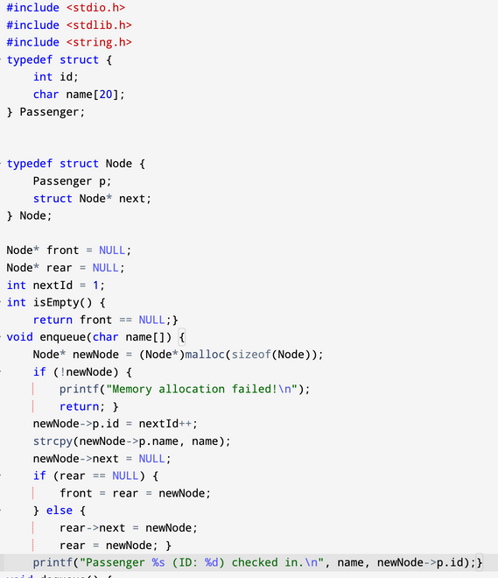
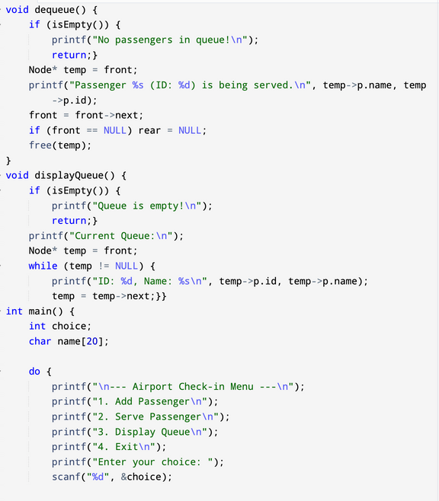
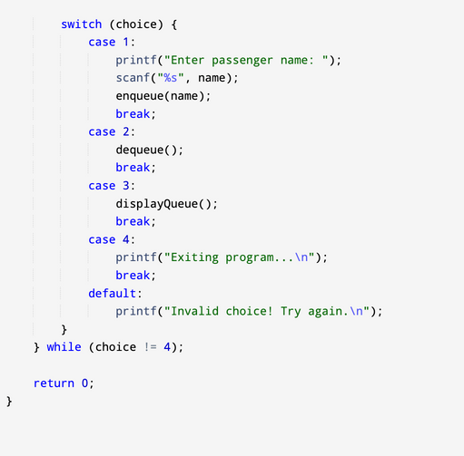
CODE

Slide 9
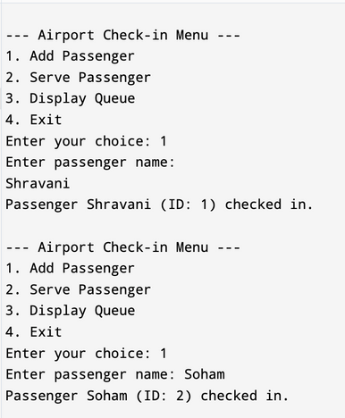
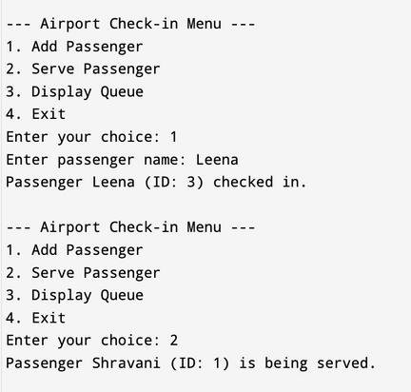
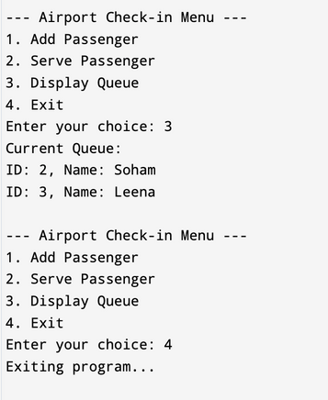
OUTPUT

Slide 10
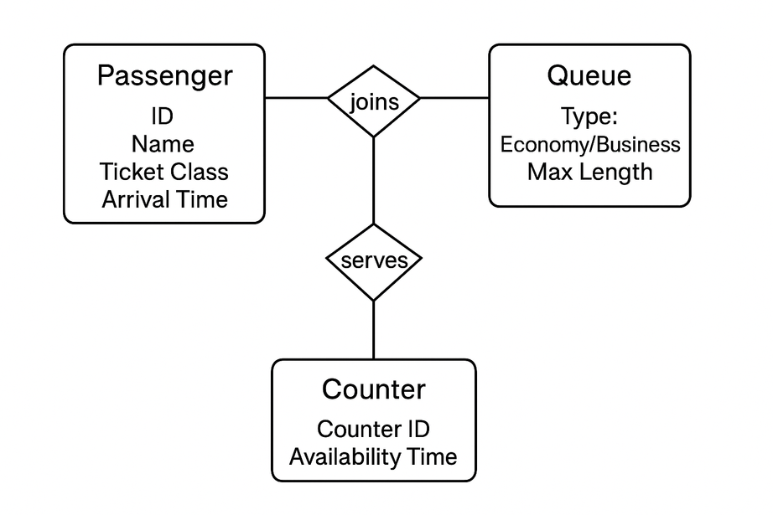
ER diagram of the proposed system

Slide 11


Conclusion
The Airport Check-in Simulation demonstrates how queues can effectively manage passenger flow in a real-world scenario. Using C language and linked list–based queue implementation, the project shows how passengers arrive, wait, and are served in a fair and systematic manner. This project highlights the practical use of data structures in solving everyday problems, while keeping the model simple and extendable for future improvements.

Slide 12


References
GeeksforGeeks, Queue Data Structure — https://www.geeksforgeeks.org/queue-data-structure
TutorialsPoint, C Programming Language Tutorial — https://www.tutorialspoint.com/cprogramming
Programiz, Data Structures and Algorithms in C — https://www.programiz.com/dsa

